Slide 1
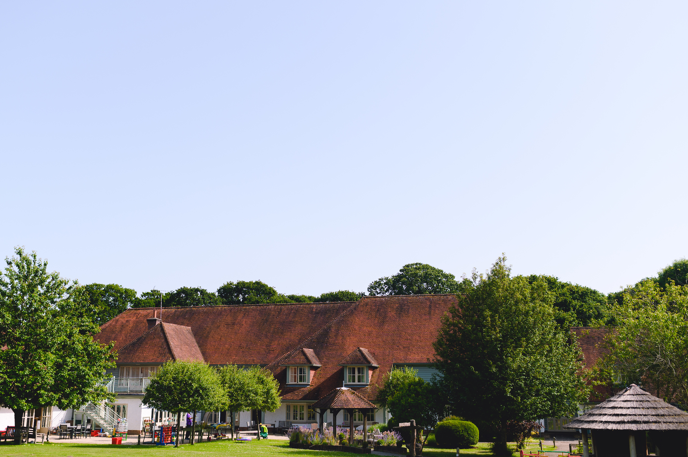
Your local children’s hospice

Slide 2
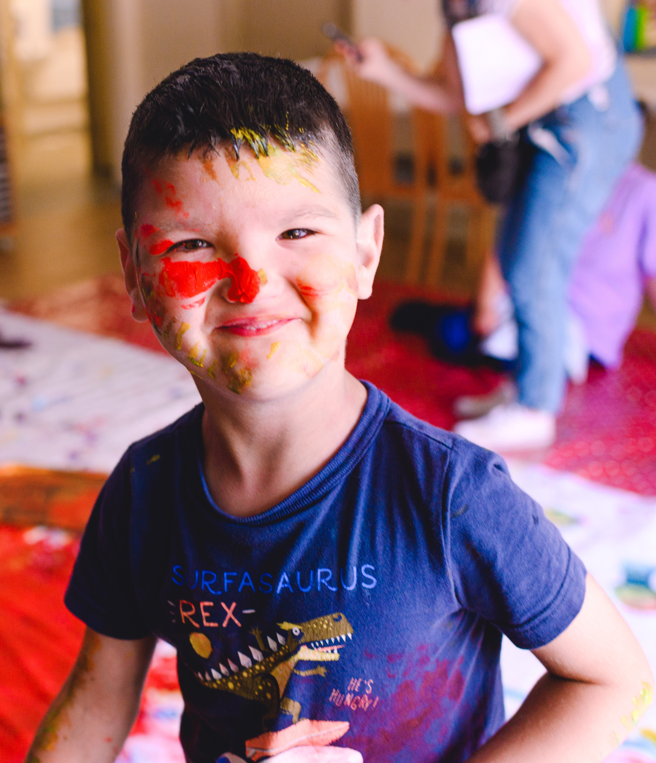

Helping children and their families live life to the full
We care for around 300 children and young people – at the hospice and in families’ own homes.

Slide 3
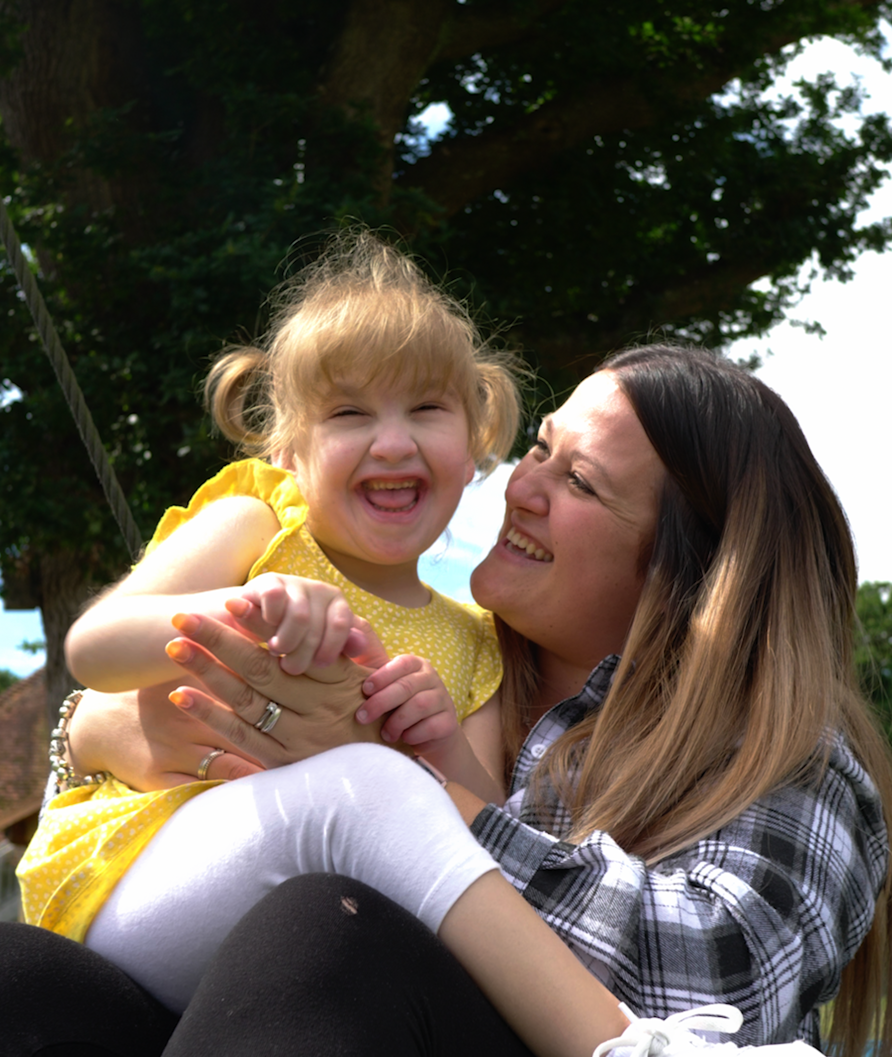

A welcoming place for all the family
Near Arundel
Overnight stays
Day visits
Fun activities
Precious memories

Slide 4
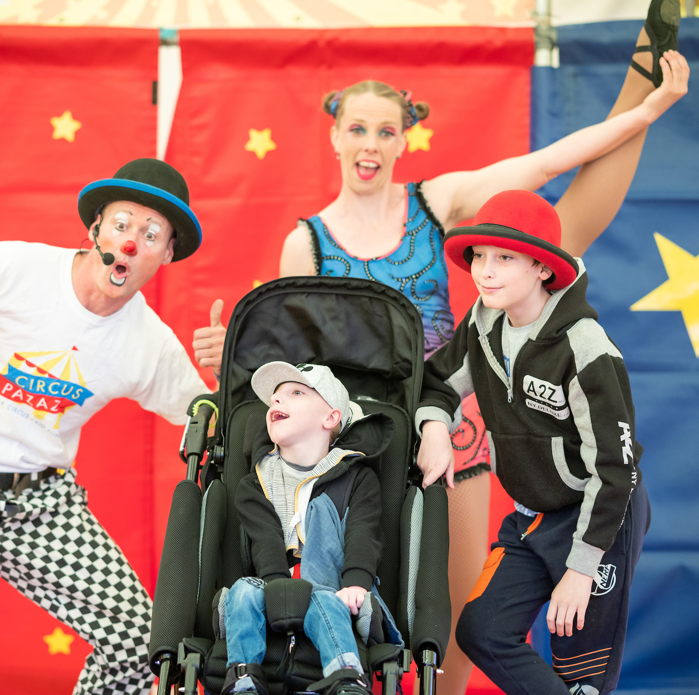
Making friends and having fun
Throughout the year there are lots of fun events for families to attend at the hospice and in venues near to where they live.

Slide 5
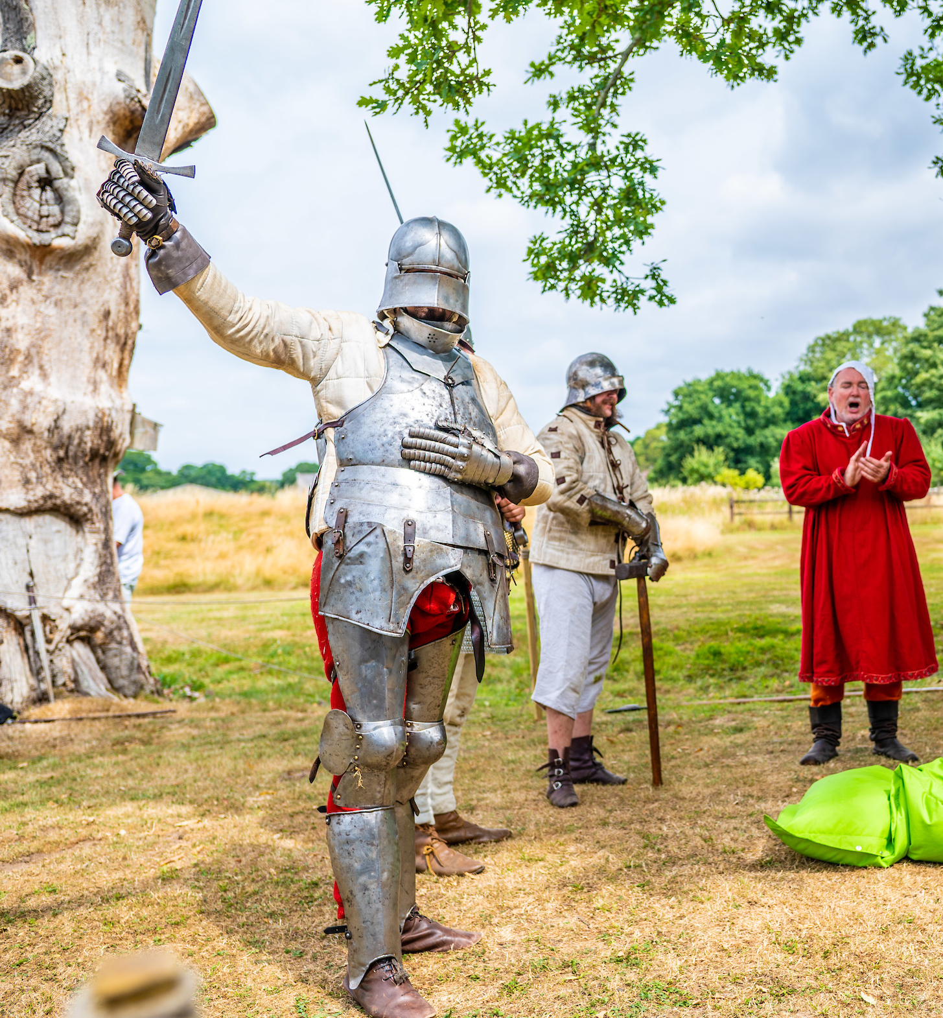
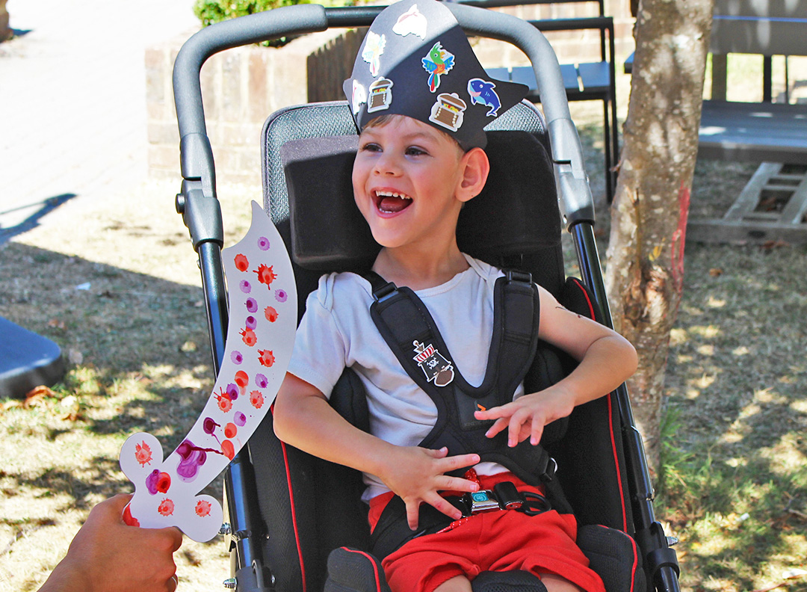
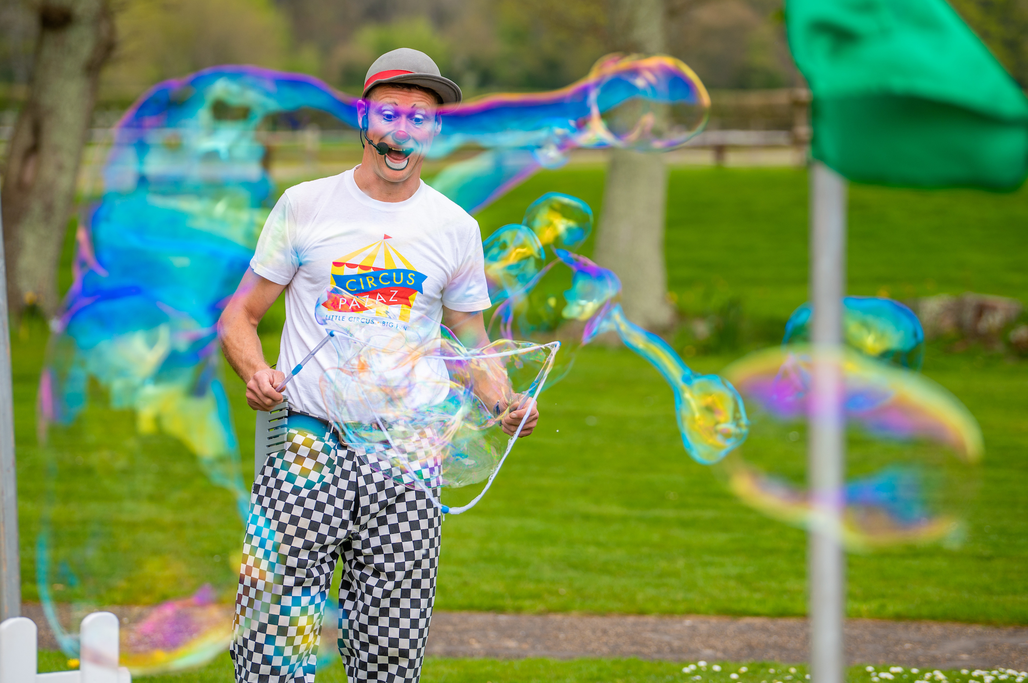
Notes:
A Medieval Day where families had a chance to travel back in time and watch brave knights do battle
A Pirate Party where families could walk the plank and enjoy pirate sensory play
Amazing bubble shows

Slide 6
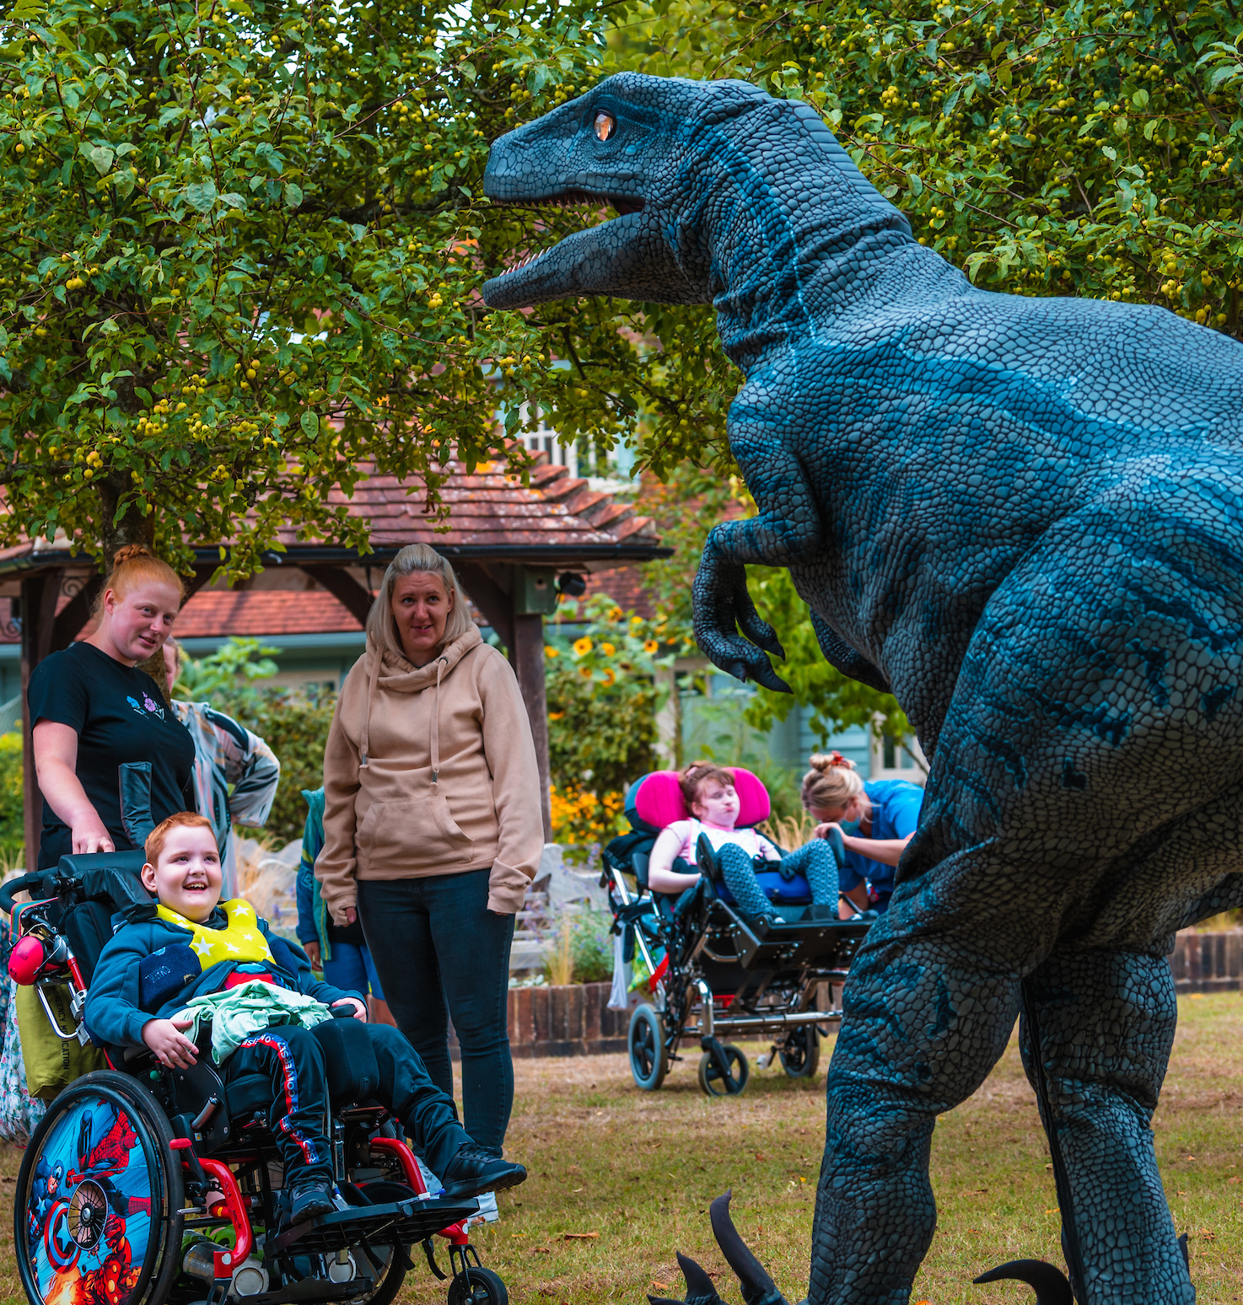

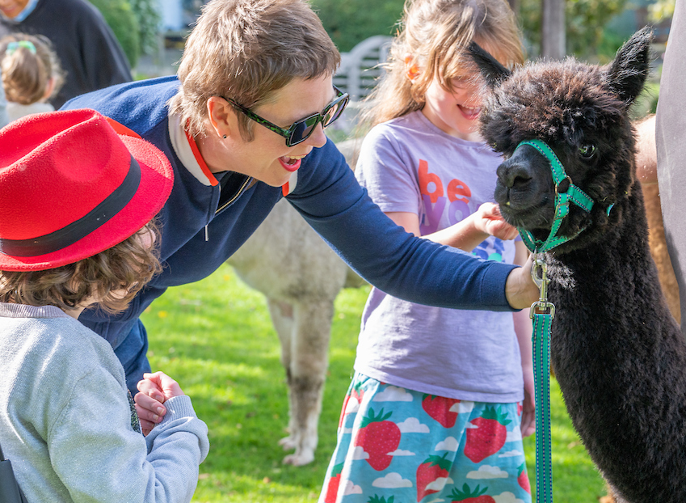
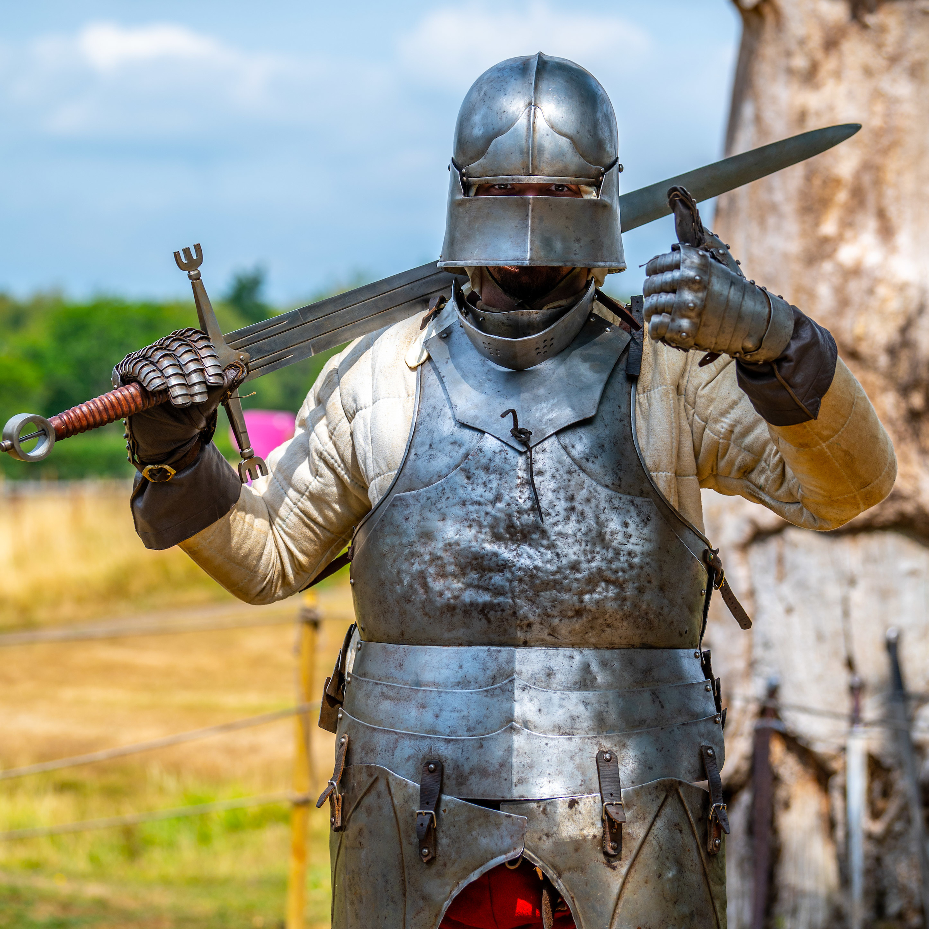
Notes:
Harry Potter day – a chance to make sensory potions and play Quidditch
A visit from dinosaurs, big and small, who took over the Chestnut Tree House gardens
Lots of animal visits including llamas….

Slide 7
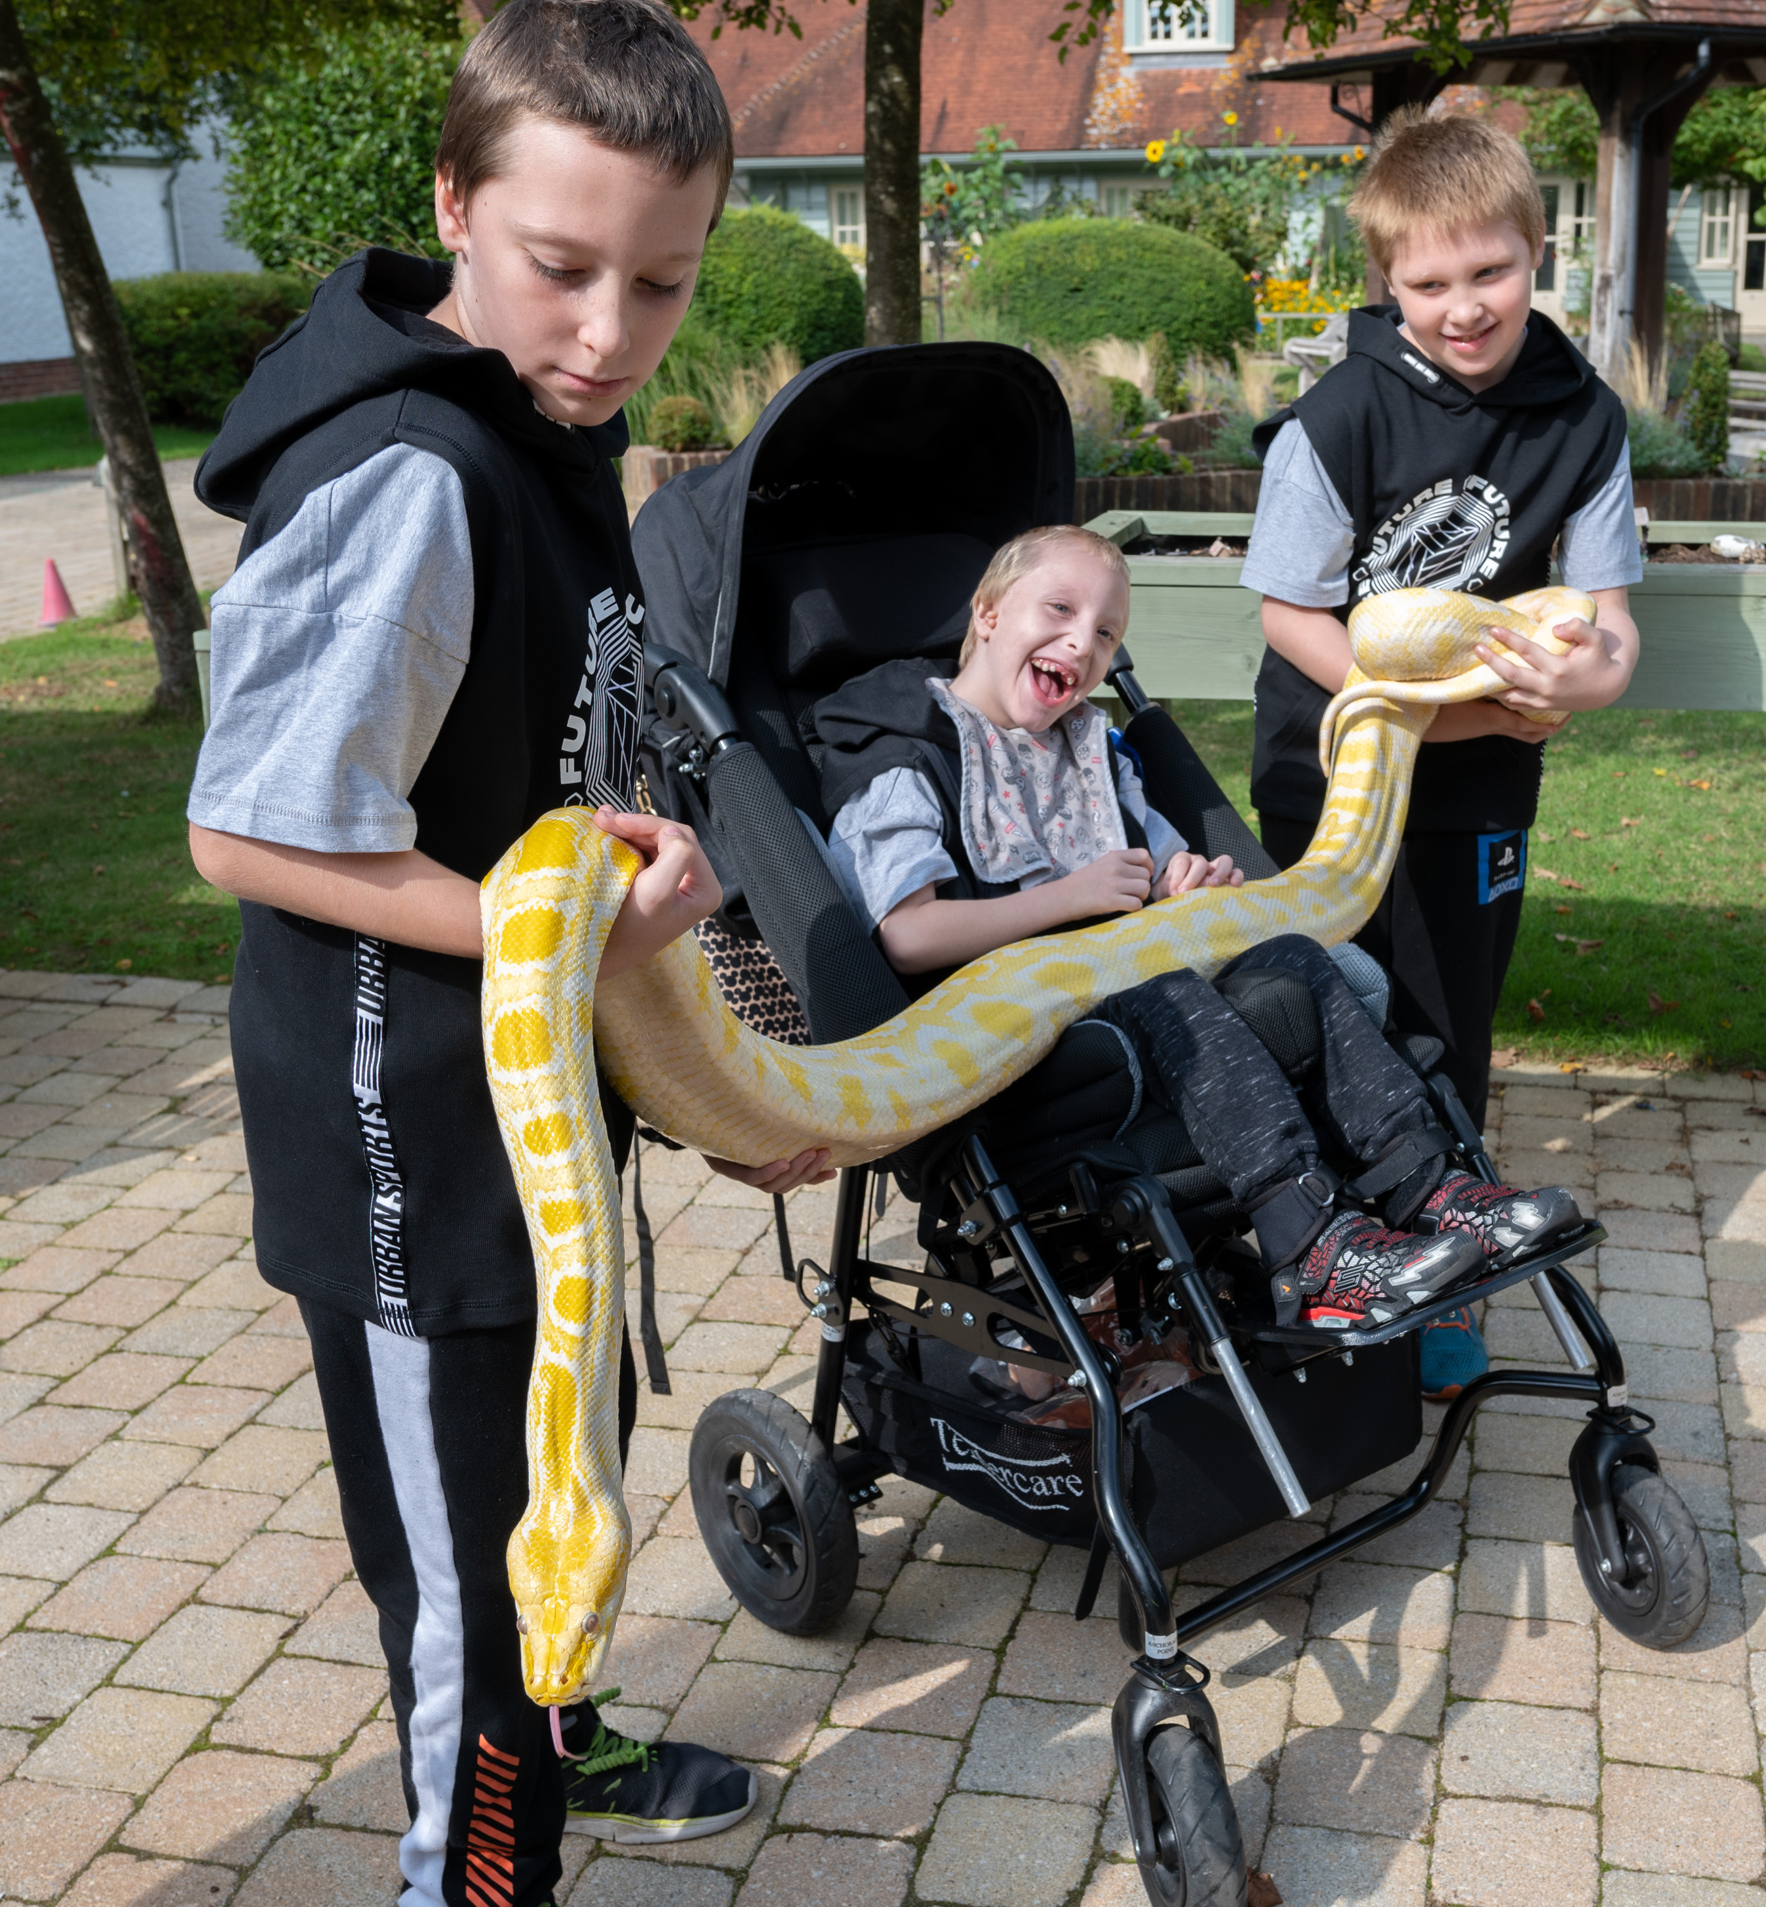
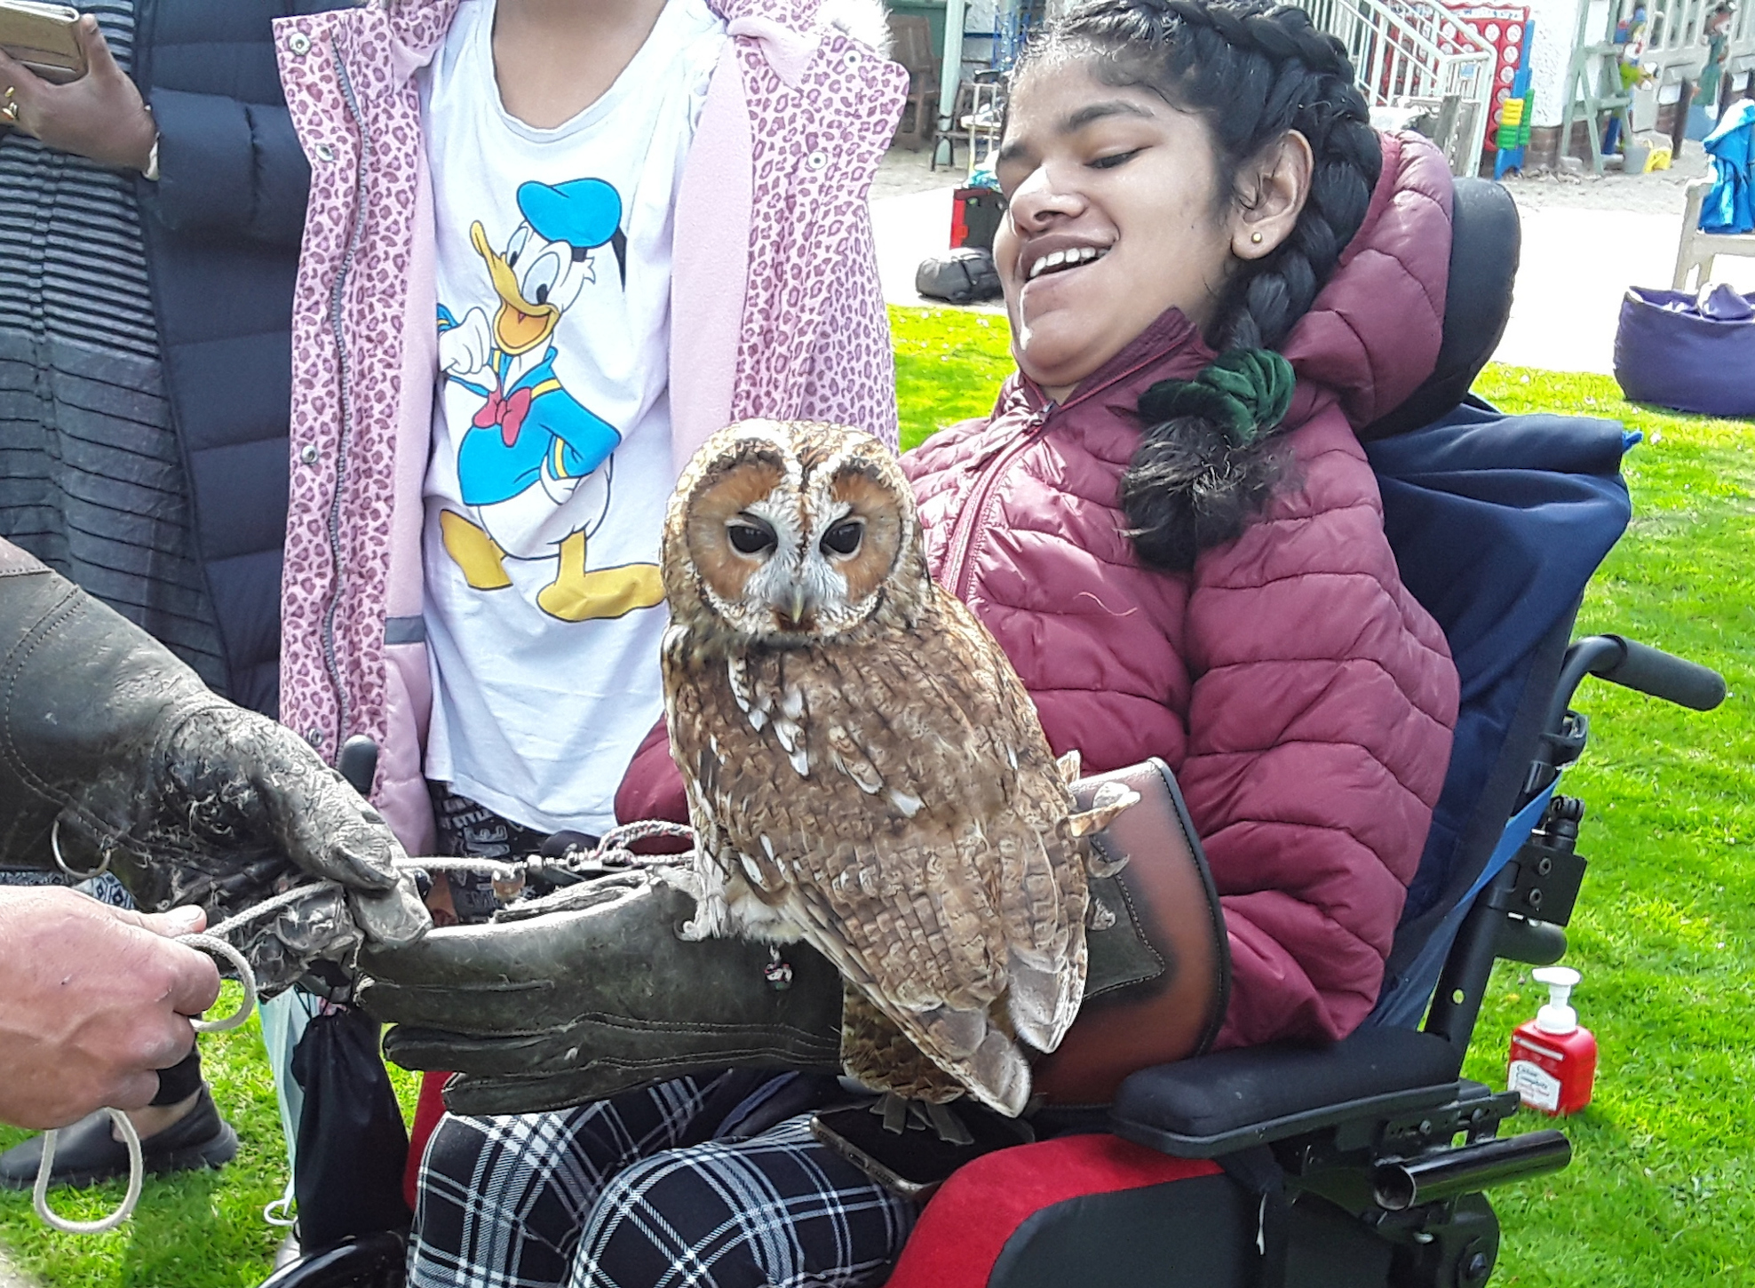
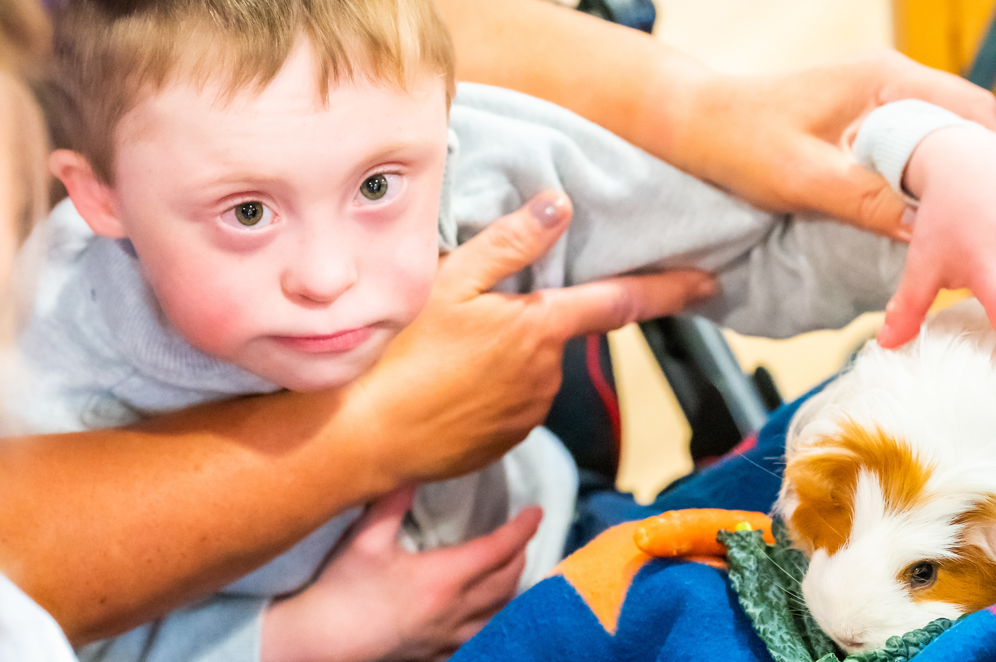
Notes:
Reptiles and giant snakes, owls and birds of prey and some slightly more cuddly creatures!

Slide 8
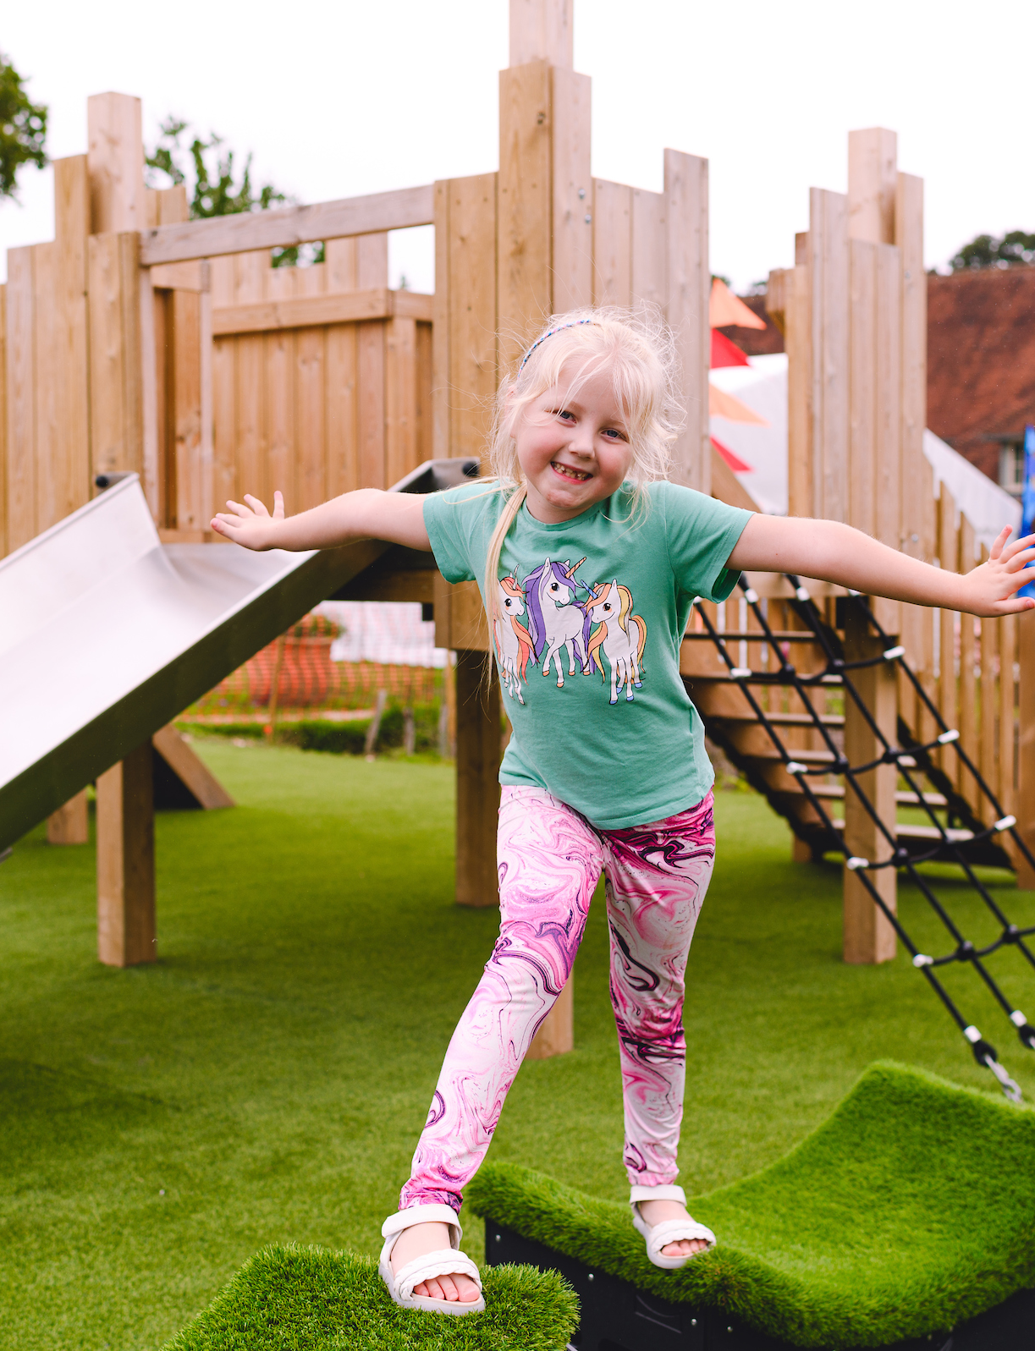

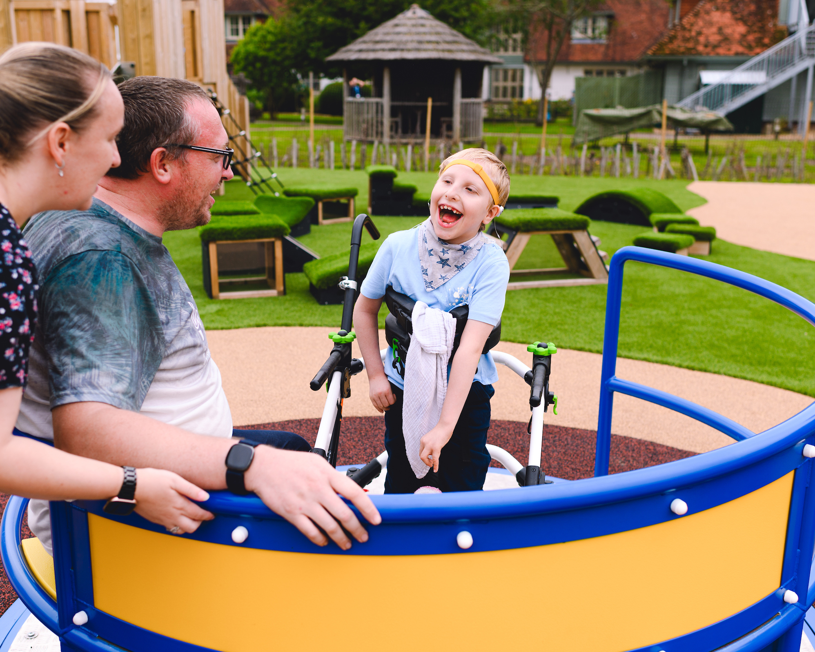
Fun outdoors
The gardens are always busy with children playing games and having fun
in the adventure play park.
Notes:
Our beautiful grounds and gardens provide a chance to play and have fun in the fresh air, and all children’s bedrooms look out onto the gardens, which are easily accessible – we can even take beds outside.
We’re surrounded by beautiful nature - you may see the resident herd of wild deer bouncing their way across the fields, a couple of foxes playing in the woodland and birds of prey circling our orchard.
Families love using our accessible adventure play park. For children and young people who use wheelchairs, there is a wheelchair trampoline and a wheelchair swing meaning no one misses out on outdoor fun.
Children that are more mobile also have access to a trampoline, swings, slide, and big wooden fort with climbing net, steps and a pole to slide down. There are also blocks that can be moved to create fun obstacle courses - covered in artificial grass to give them a sensory feel.

Slide 9
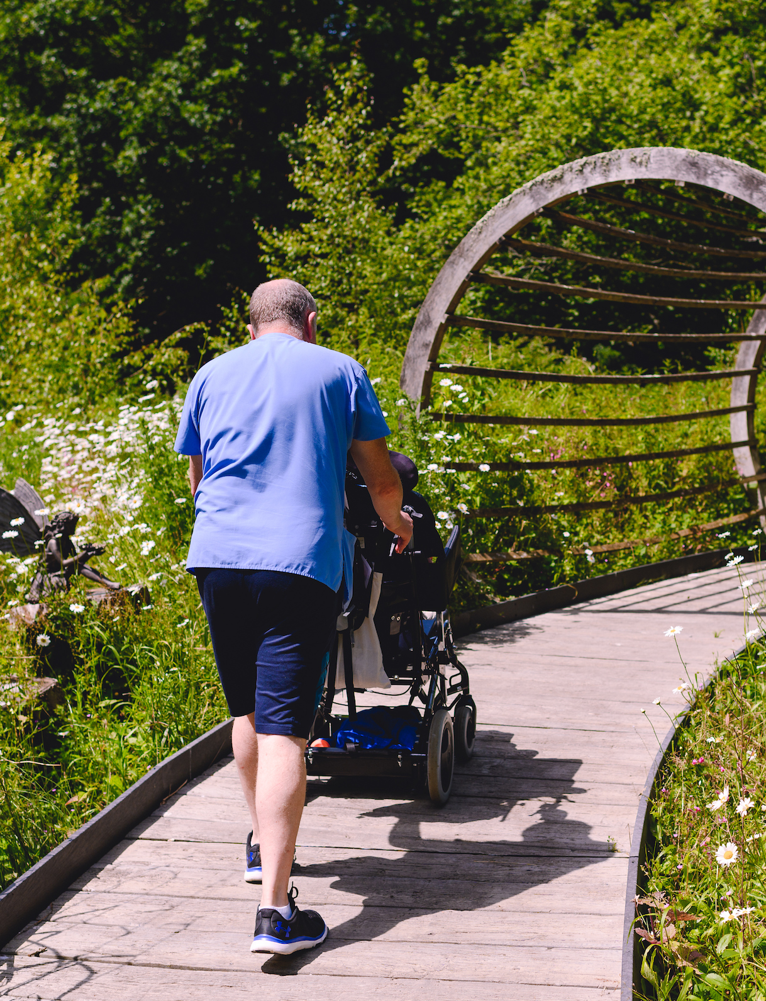

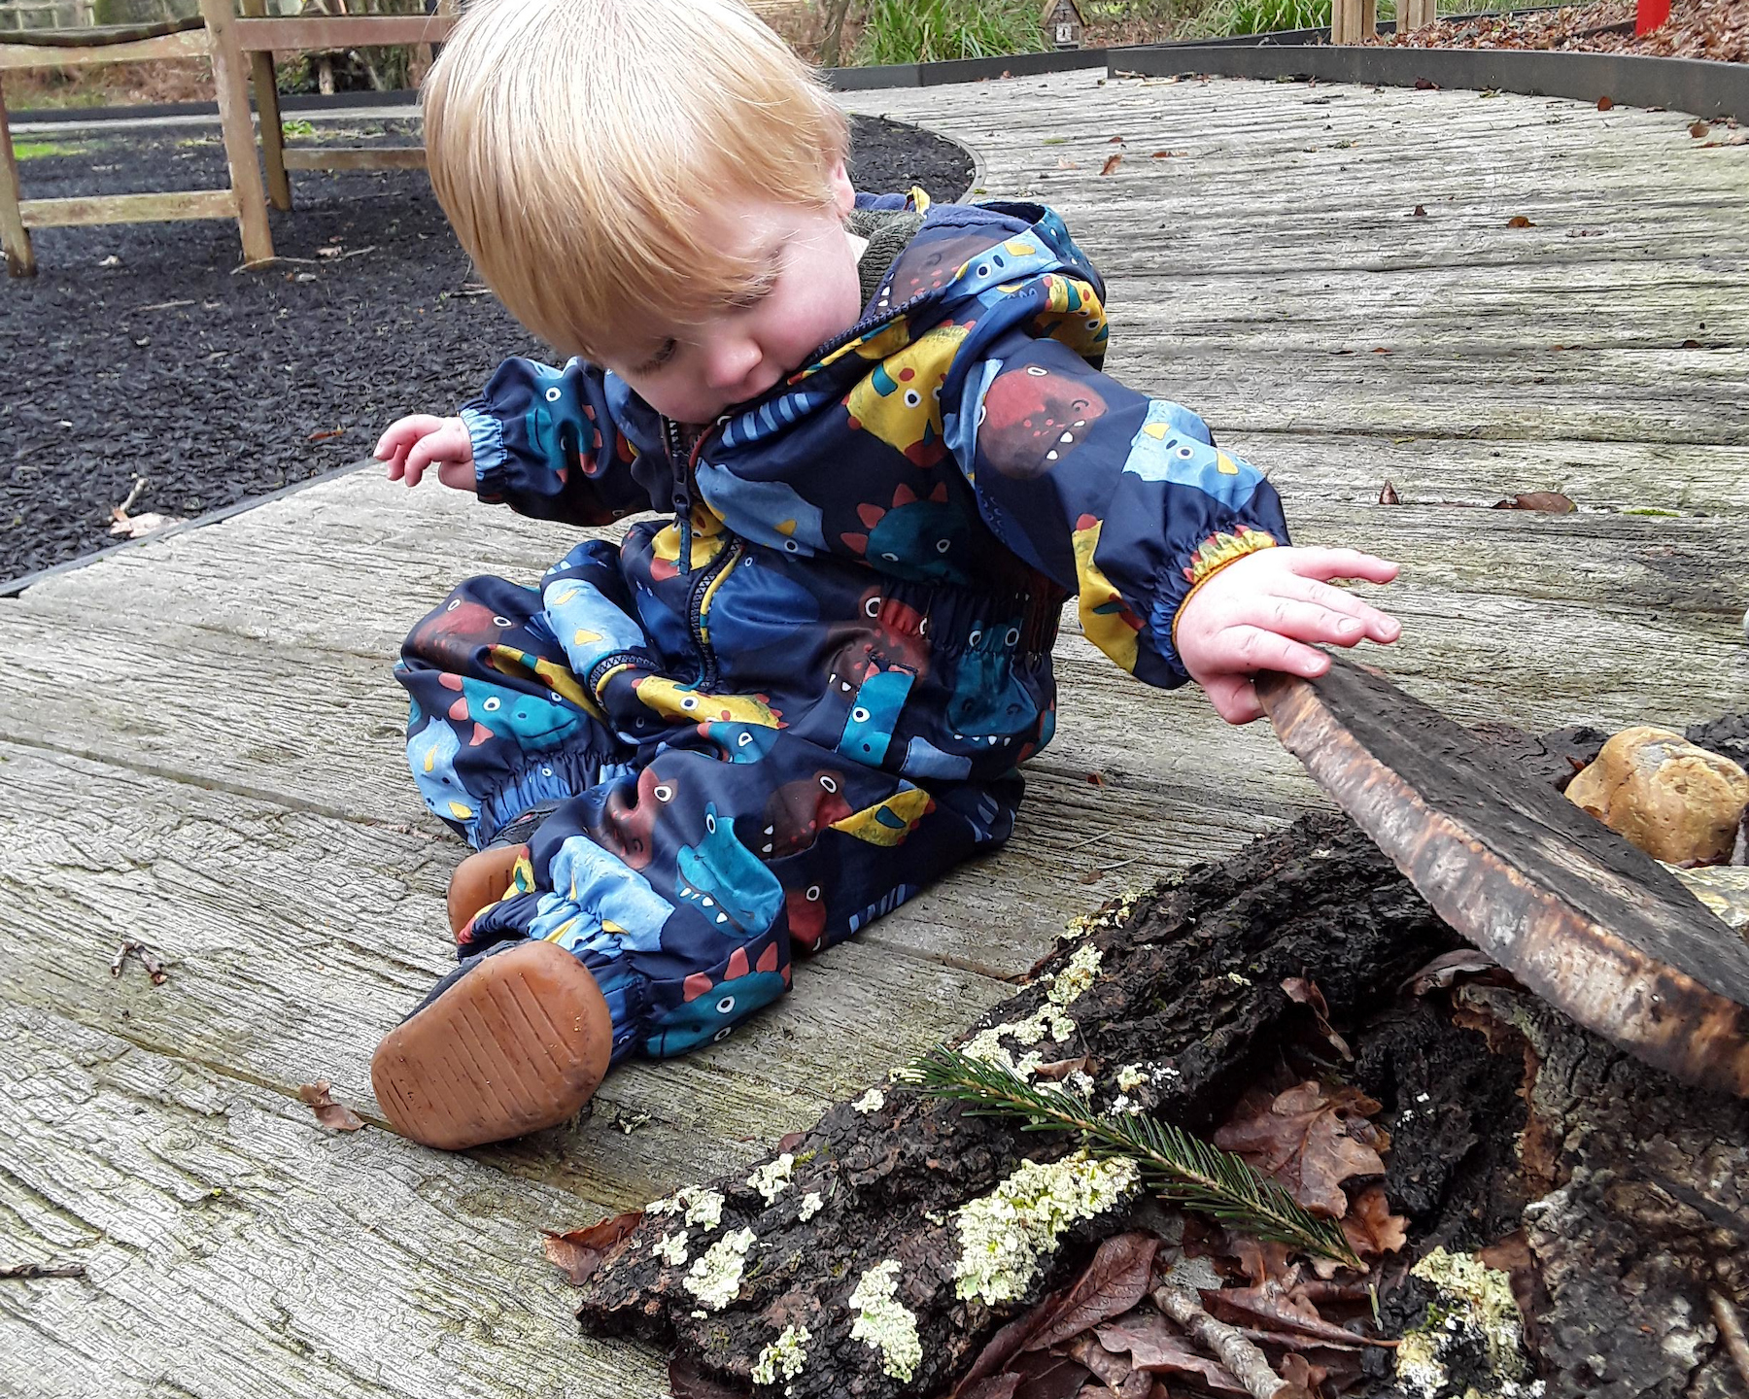
Bug hunting
Our Woodland Walk is fully wheelchair accessible and usable all year-round.
Notes:
Many of the children cared for by Chestnut Tree House are unable to visit ‘regular’ woodlands as they are often inaccessible to wheelchair users. Our Woodland Walk is accessible for children and young people in wheelchairs and beds.
We have a squirrel maze, bug hotel and dedicated bug zone in the Woodland Walk for children and young people to go on a bug hunt and explore nature. Our bug zone is an area of fallen trees – not only is this an area loved by children, it also cuts down on waste.

Slide 10
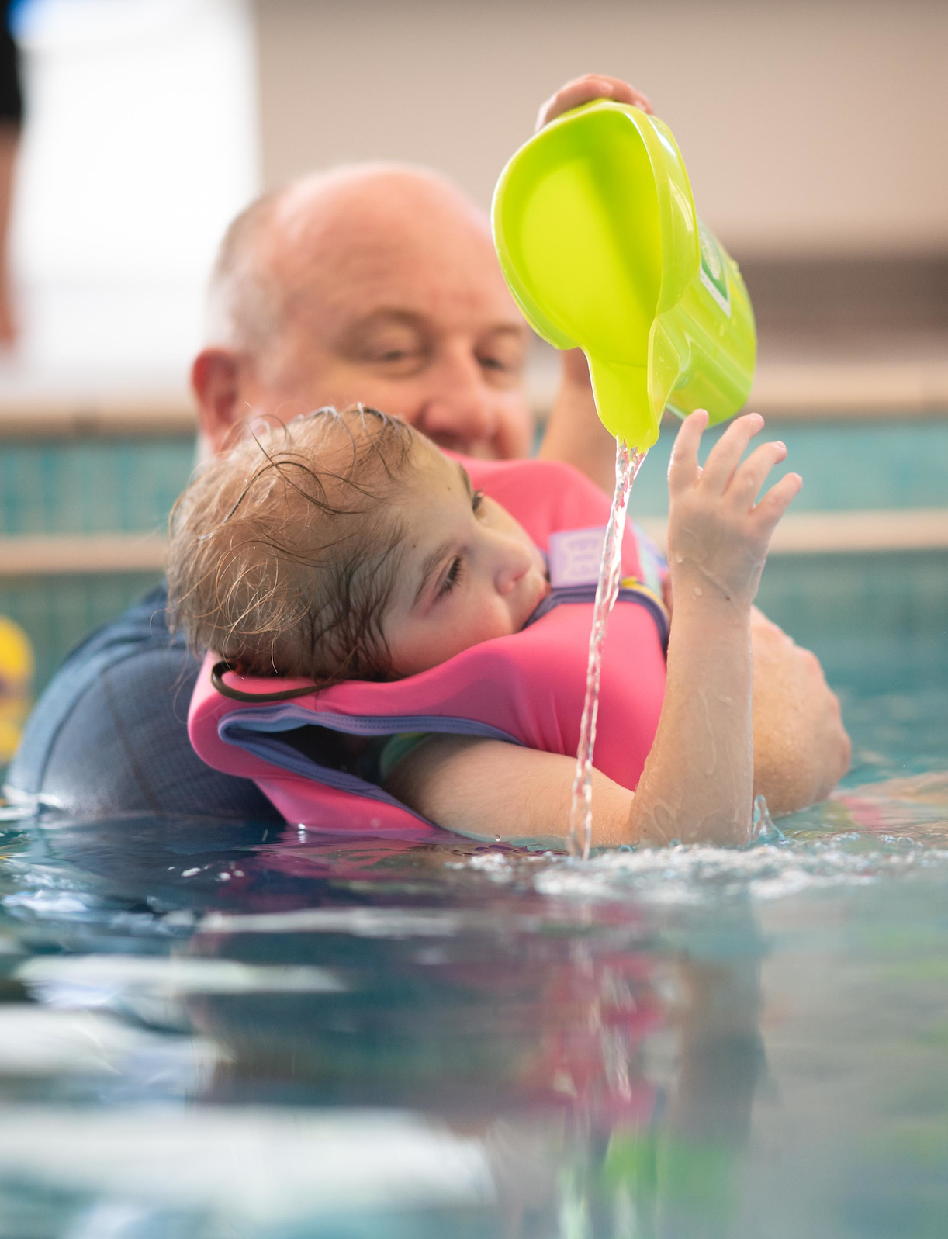


Splashing about
Our hydrotherapy pool is a safe space for everyone to enjoy, with warm water and hoists in the pool and changing areas.
We all love splashing about in the pool together. It’s one of the few times when all four of us can be together as a family, all enjoying the same thing.
Notes:
Packing a bag to spend an afternoon at a public swimming pool is something most of us take for granted. But when you’re caring for a child with a life-limiting condition, a family trip to the local leisure centre often isn’t an option.
Many of the children we care for can’t tolerate the temperature of the water in public pools and get cold very quickly, or they may have sensory issues and find it too noisy and overwhelming. Often there aren’t hoists which mean young people in wheelchairs can’t get into the pool, and the changing rooms and showers can be too difficult to manage.
This means that for many of the children and young people we care for, the only opportunity they have to play or relax in a pool is during a visit or stay at Chestnut Tree House. Our swimming pool is very special.
It’s warm, safe and accessible, allowing all of the children to enjoy the relaxing and fun benefits of the pool. There is a hoist system on the ceiling that enable the nurses to gently lift the children from their wheelchairs into the pool.
It may be the first time some of the children have ever been in a swimming pool.

Slide 11
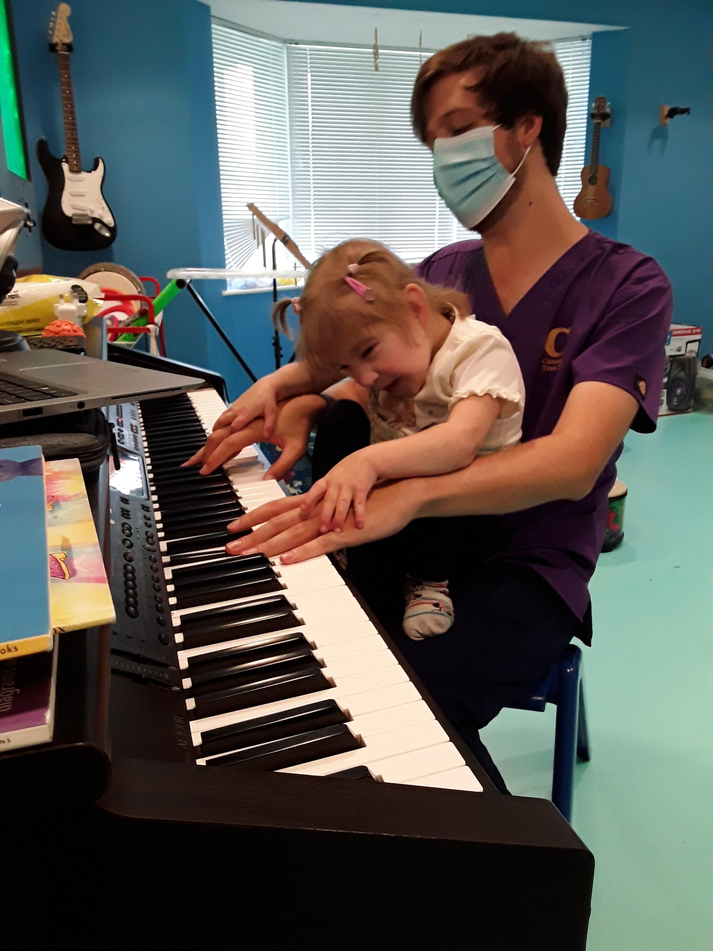

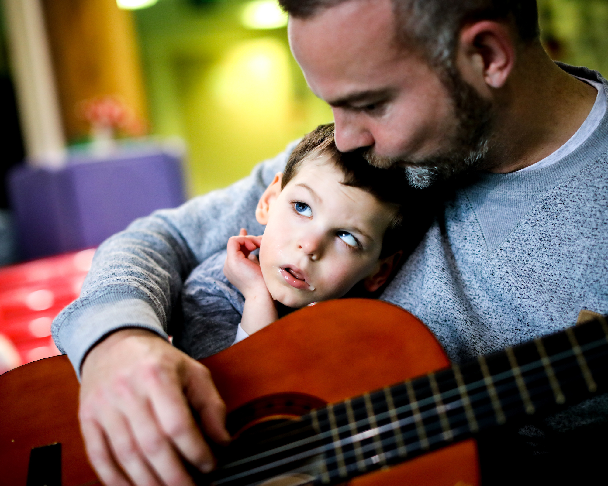
Making noise
You’re never far from music at Chestnut Tree House.
Notes:
Listen carefully and you’ll find you’re never far from music at Chestnut Tree House. Whether it’s a family drumming session in the woodland walk, a storytelling singalong in the music room, a karaoke night, or listening to dad play the guitar– music is at the heart of so much of what we do.
Here at the House there’s a dedicated music room full of instruments including guitars, keyboards, drums and shakers. It’s really important that everyone can join in, no matter what their needs, so there’s also some instruments you might be less familiar with – like our interactive Beamz music system that allows the children to make different sounds simply by touching the laser beams with their hands.

Slide 12
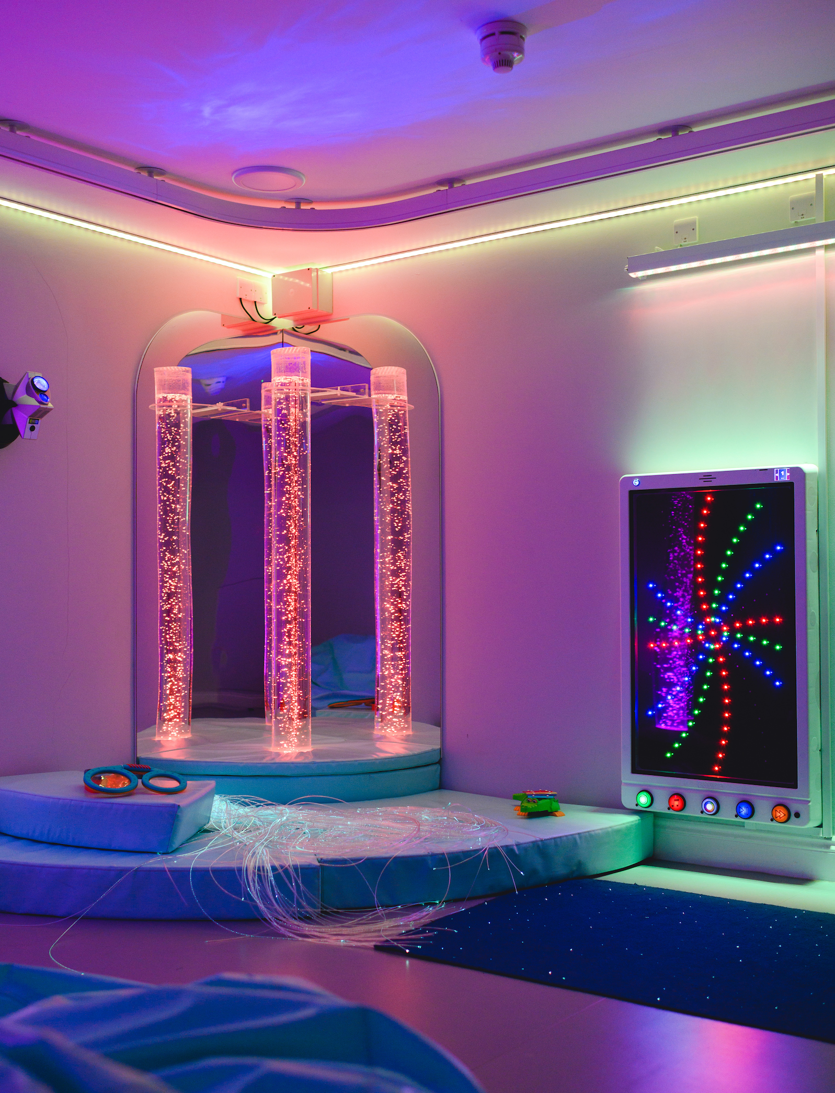

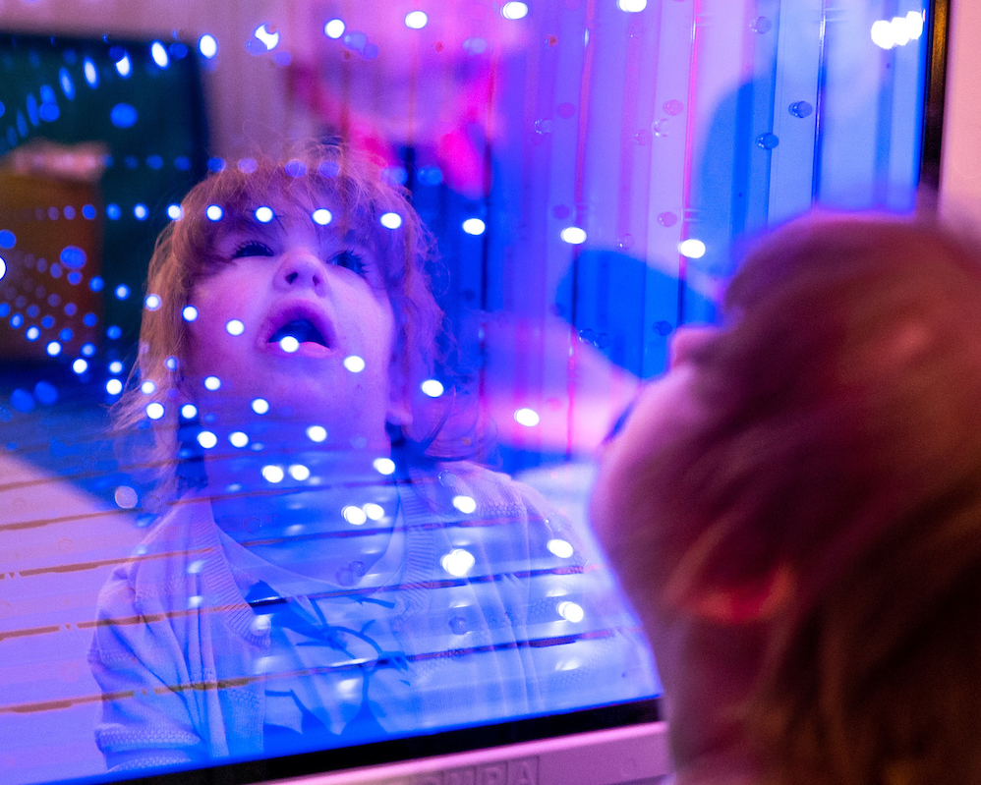
Relaxing spaces
Children can relax in our multi-sensory room or take a ride on our magic carpet.

Slide 13
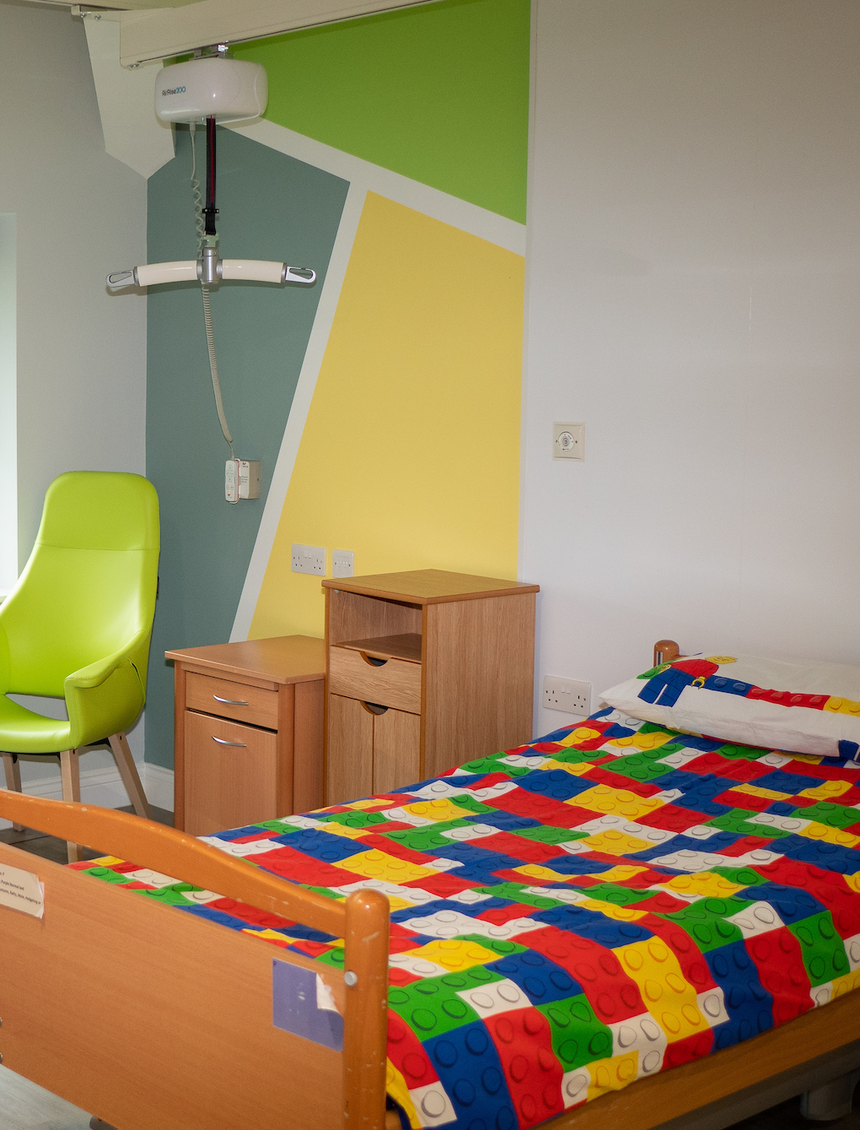
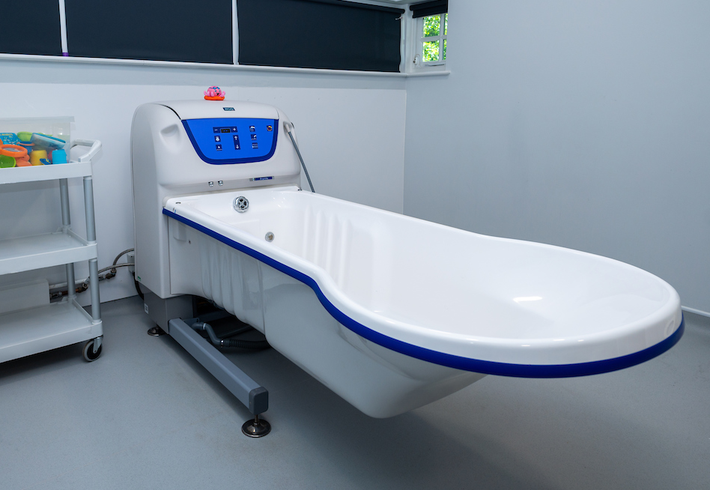
Bath and bedtime
Children have their own bedrooms and love to splash about in the jacuzzi bath. Families can stay close by.
Notes:
Children and young people have their own rooms and families can stay close by in one of our family rooms. Families also have their own lounge where they can relax and all meals are cooked for them.
The jacuzzi baths are big and deep allowing children to relax in the warm water before going to bed.
Many of the children don’t have baths at home, as they cannot get in and out of a normal bath, so they get very excited about having a bath when they come and visit.
There is a special hoist system in the bathrooms just like the swimming pool
One 12-year-old girl staying spent 4 hours in the bath and even had her lunch in the bath on a tray.

Slide 14
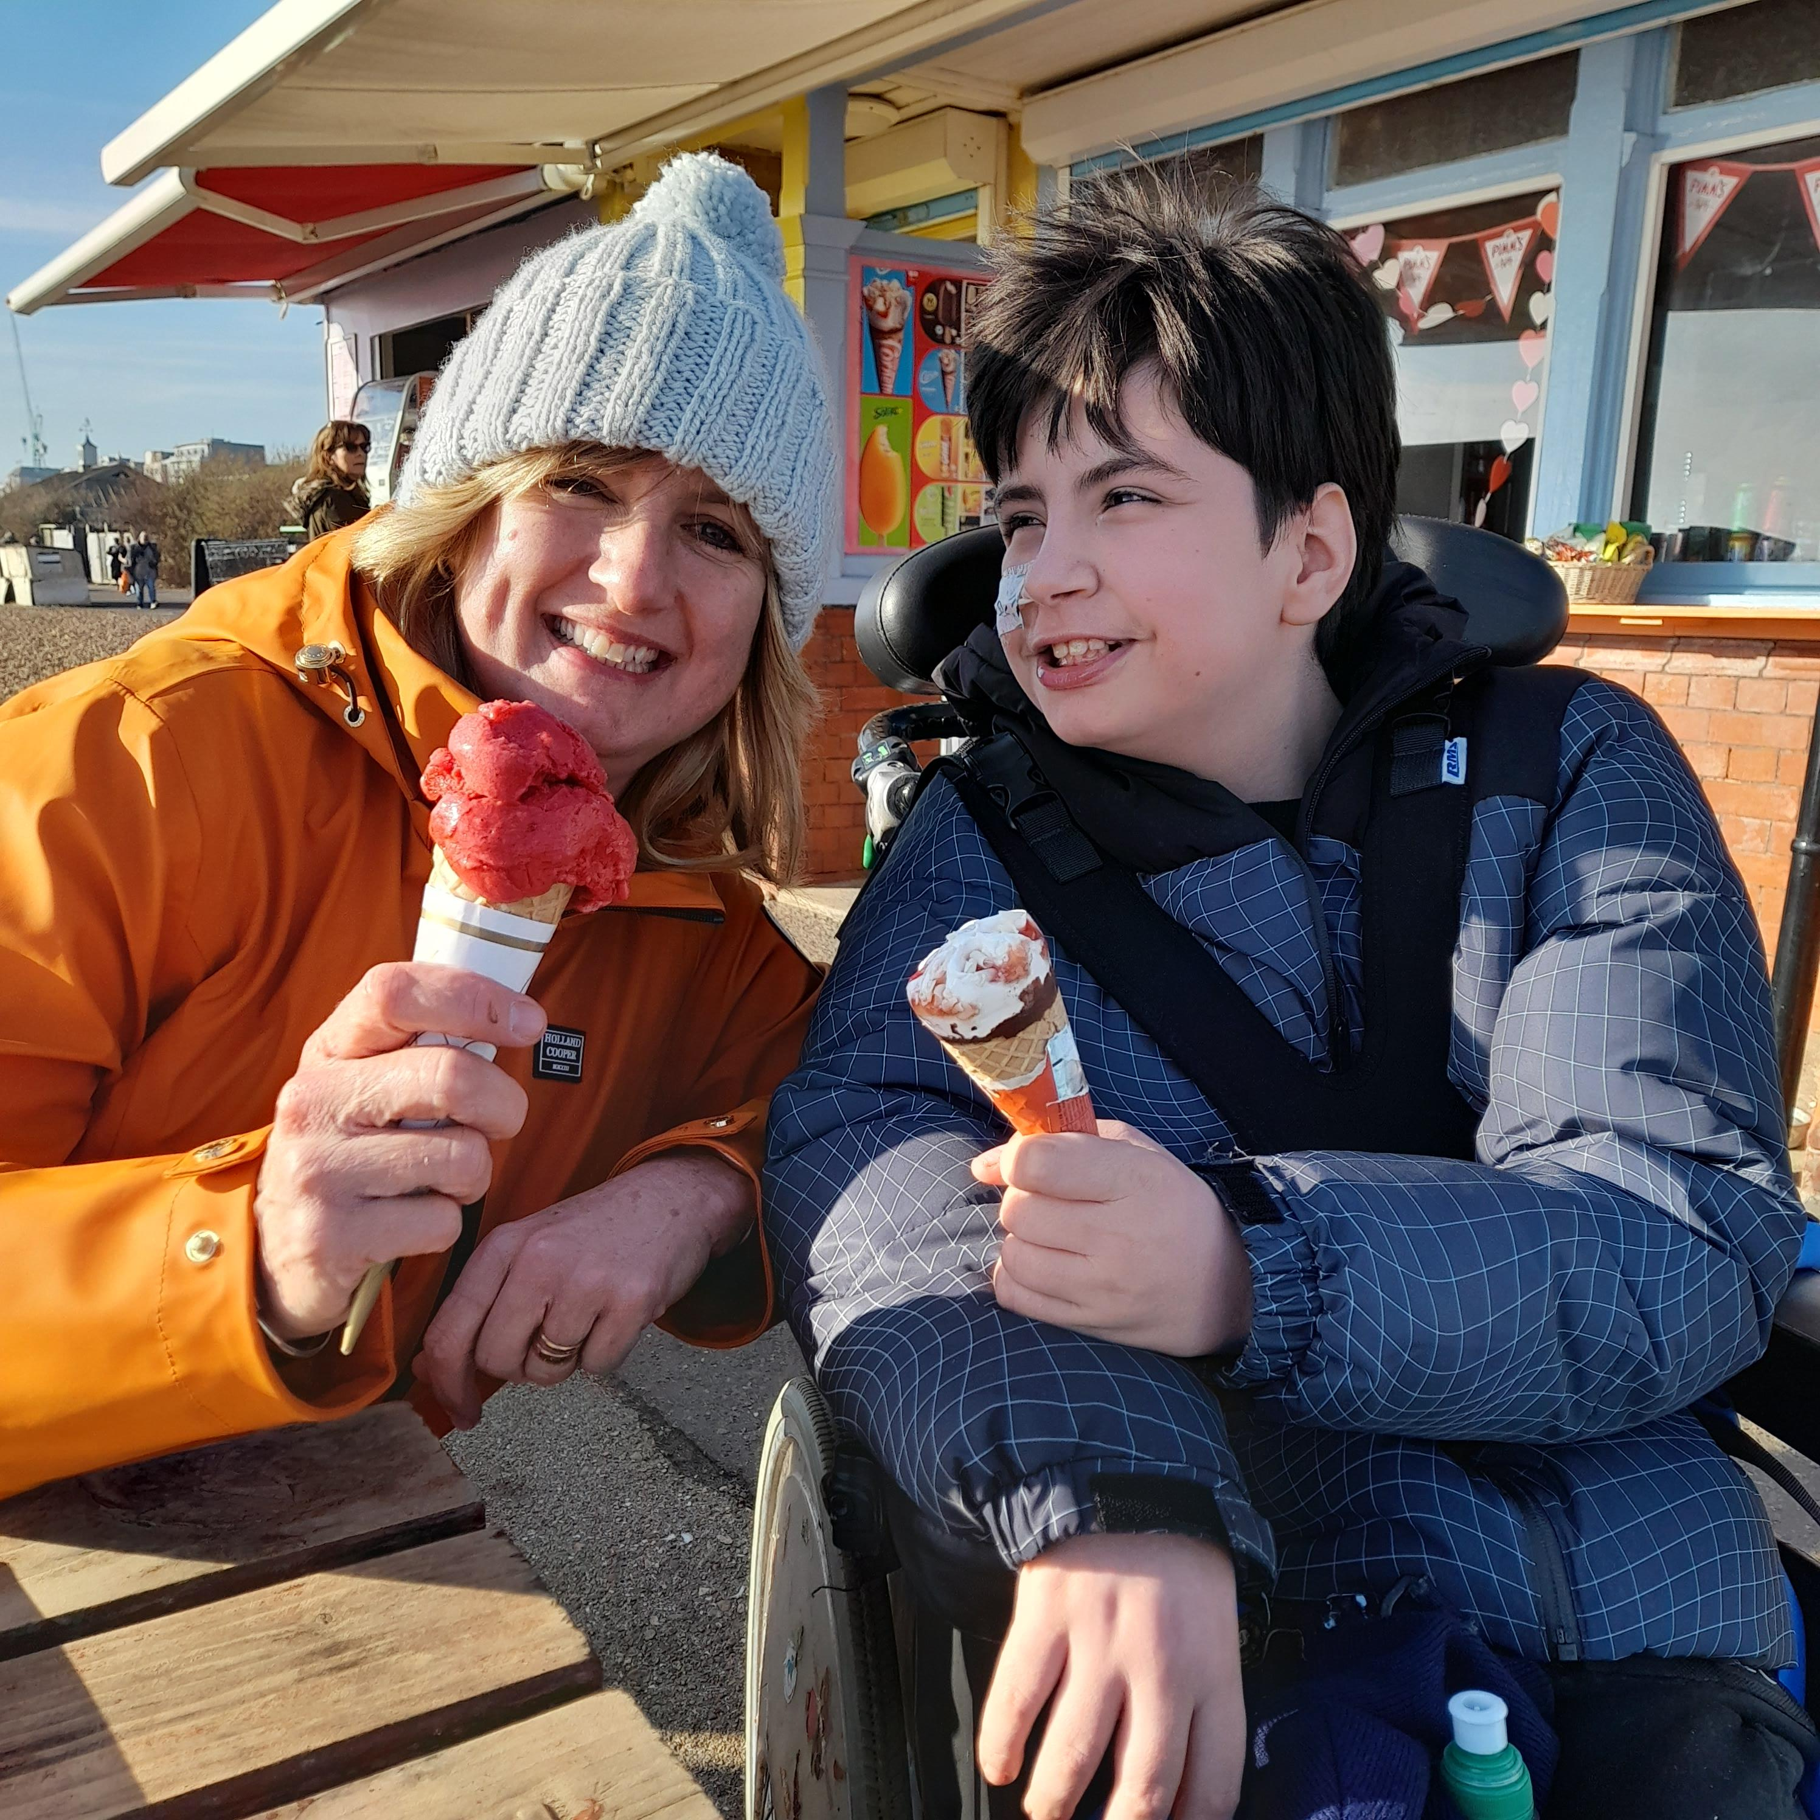

Care in the community
Help in families’ own homes
Fun trips out
A chance to make new friends
A break for tired parents
Notes:
As well as care provided at Chestnut Tree House, nurses also visit families in their homes.
They take children on fun trips out, such as to the local park, bowling alley or even speedboating. And for their parents it’s a chance to have a rest, catch up on some sleep or spend time with their other children.

Slide 15
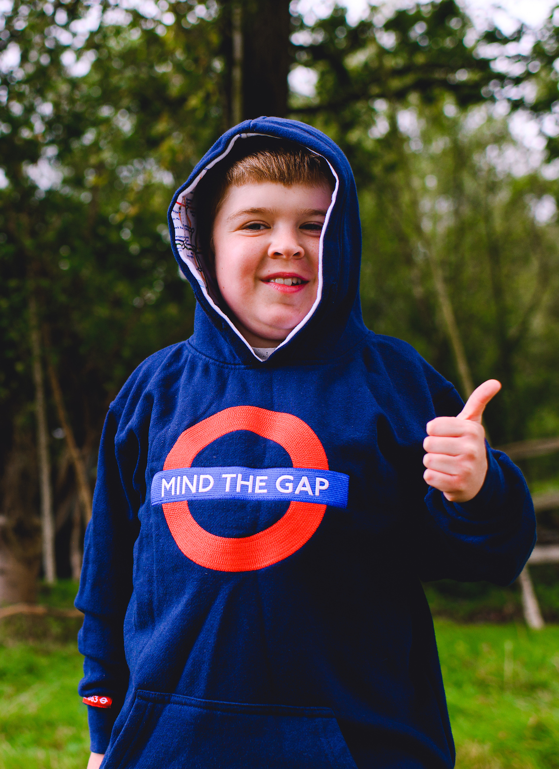
How much does it cost?
Over £5 million is needed every year to provide hospice care for local children.
Only 17% of this comes from government funding. The rest – around £10,000 per day – comes from donations and fundraising.
Fundraise
Take on a challenge
Donate
Get involved
Notes:
Families are never charged for care,, it is paid for by the support and generosity of the local community. Here are some ways you can help:
Fundraise
You could organise an event such as concert, tea party or sponsored walk.
Take on a challenge
You can organise your own or pick from a range of Chestnut Tree House challenges which include runs, abseils, skydives, cycling events and our annual Castle Night Trek. We also run overseas treks for our most adventurous challenge seekers.
Donate
Make a donation, give regular gifts, join the Chestnut Lottery (and be in with a chance of winning a top prize of 1,000 every week!) or leave a gift in your Will.
Get involved
Could you give your time and volunteer? Visit your local Chestnut Tree House charity shop? Or make us your charity of the year?

Slide 16
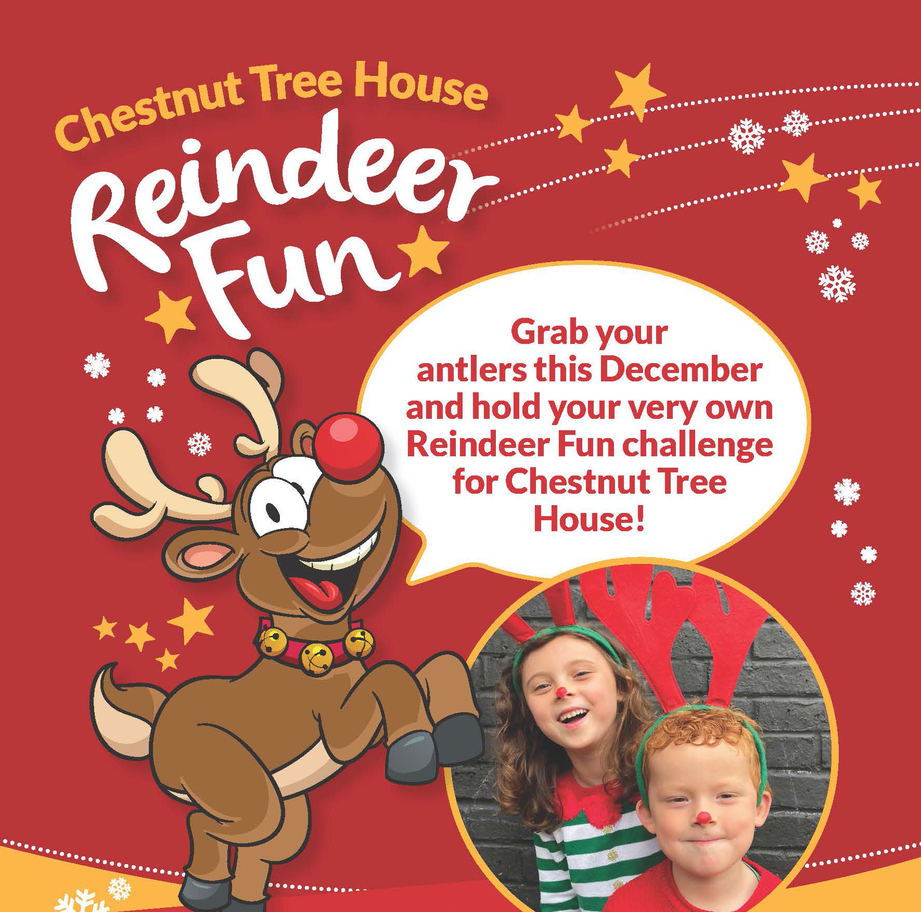

Slide 17
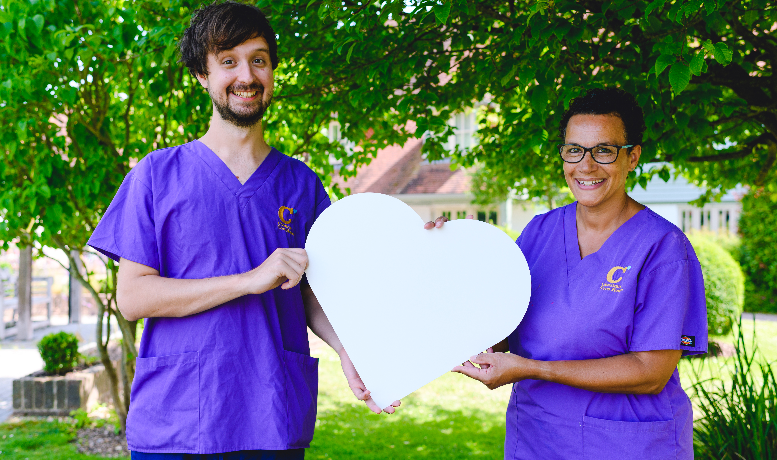
Thank you
Notes:
We’re here for families every step of the way. But this wouldn’t be possible without your generosity and support.
A huge, heartfelt 'Thank you' to everyone who raises money, awareness and gives their time to volunteer.

